Slide 1
Steps To Solve A Problem
Chapter - 5

Slide 2
What Is Computational Problem?
Requires computer to solve.
Solves in logical approach.
Solution read by humans and computer.
Also called computational thinking.
Types of computational problem are:
Decision problem has Yes or No solution.
Search problem has string as answer.
Counting problem has number of solutions.
Optimization has optimal solution.

Slide 3
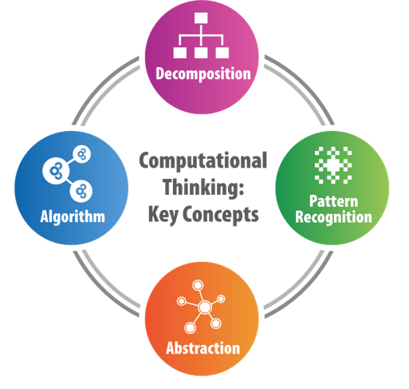
The Four Cornerstones Of Computational Thinking
Computational thinking and programming are different.
Programming tells computer to perform action.
Thinking encourages on what to say to computer.
To arrive at solution, break problem as:
Decomposition of problems into manageable modules.
Recognizing patterns or similarities in smaller parts.
Focus on key elements only or abstract.
Follow a step-by-step method to solve.

Slide 4
Five Step Method To Problem Solving
The five step method is scrutinized as:
Identification of the problem.
Performing mathematical modeling for computational method.
Developing a computational method for problem solving.
Execution of computational method.
Assess for ensuring quality of solutions.

Slide 5
Tools To Help In Problem Solving
Problem solving is challenging.
Programs solve problems in steps.
The tools for problem solving are:
Pseudo code or algorithms express computational process.
Flowcharts describes instruction sets, decision steps and sequential steps visually.
Mathematical model using theories for scientifically acceptable solution.
Operators that represent the validity of objects.
Logic to generate relevant output for given inputs.

Slide 6
Tips For Solving A Problem
Initiate with a plan every time.
Restating the problem for understanding.
Dividing the problems into chunks for clarity.
Start solving with the information available.
Lower the complexity of problem.
Finding analogies.
Trial and error for solution at some stages.
Work with the solutions you already have and improve the system.

